Slide 1


Contract amendment and contract control system in Hungary
Balázs Bakos
Head of Department
Department for the Control of Contracts
Public Procurement Authority
Zagreb
23 April 2024

Slide 2

Abstract
Contract amendment
The contract control procedure of the Public Procurement Authority – contract control in practice
Typical infringements, results

Slide 3
Contract Amendment

Slide 4
Contract amendment - Changing the content items of the contract
The possible cases of contract amendment
Legal bases: the contract may be amended upon the full compliance with the criteria (v. contractual freedom):
  3 groups > 5 legal bases <Article 141 (2), (4) a)-b)-c), (6) of the PPA> + special rules of public utilities
  Lawful upon the fulfilment of any legal basis – enough to fulfil one
  No ranking among the legal bases
  Change of the value (if relevant): adding-up by legal basis
  Forbidden: hiding a breach of contract, absorbance of the cost of additional works, taking of risks (Article 142 (3) of the PPA) see: Government Decree No.13/2023
  Preparation: strive for avoiding contract amendment - relativize

Slide 5
Contract amendment - Changing the content items of the contract
The possible cases of contract amendment
If no criteria of the legal bases is fulfilled: new public procurement procedure has to be conducted – Article 141 (8) of the PPA.
Avoidance of the PPA occurs if there is no lawful contract amendment or public procurement procedure to cover the new procurement need.
ECJ judgement C-263/19. – the tenderer can also be held liable for unlawful contract amendment, but the avoidance of the PPA shall be considered in terms of the contracting authority
Especially important changes in content:
  Technical content changes
  Deadline changes
  Value changes

Slide 6
Contract amendment - Changing the content items of the contract
The possible cases of contract amendment
Article 141 of the PPA – obligation to publish a notice (except Article 141(4) a) – Decree of the Minister of the Prime Minister’s Office No. 44/2015.
Reference to the legal basis, correct justification
„Switch” between the legal bases is possible: fulfilment of the criteria of contract amendment: question of fact, so a not marked legal basis can be referred to subsequently, BUT only the circumstances complying with the justification in the notices can be taken into account – Court Judgement No. Kfv.VI.37.948/2019/5.: „…a circumstance justifying the contract amendment, which was not included in the notice, shall not be taken into account, even if it justifies the fulfilment of Article 141 (4) ca) of the PPA.”

Slide 7
Contract amendment - Changing the content items of the contract
The possible cases of contract amendment
De minimis – changes of the value +/- Article 141(2) of the PPA
Occurrence of circumstances determined – Article 141(4) of the PPA
Non-substantial amendment – Article 141(6) of the PPA: illustrative list: what shall be considered to be essential

Slide 8
Contract amendment
Article 142 (3) of the PPA – Null and void contract amendment
Even if any legal basis is fulfilled, the contract amendment shall be null and void, if it is aimed at:
  Exemption of the tenderer from breaching the contract
    E.g. no claim is pursued upon missing a deadline with liquidated damages and additional deadline is set for the performance
  The costs of extra work to be borne by the tenderer is absorbed by the contracting authority (flat fee) – is not void, if the cost of the extra work was unforeseen
  Unjustified risk to be borne by the tenderer is undertaken by the contracting authority
    BUT! Article 2 (5) of Government Decree No. 13/2023 – undertaking half of the extra costs exceeding normal business risk shall not be considered unjustified
    See: ÉKM Decree No. 4/2023
Legal consequence: The Authority initiates legal proceeding for nullity - Article 175 (1) of the PPA

Slide 9
The contract control procedure of the Public Procurement Auhtority – contract control
in practice

Slide 10
The contract control procedure of the Public Procurement Authority
The Hungarian public procurement system and the control of public procurement is complex, the control of public contracts carried out by the Public Procurement Authority is just a part of this system.
Public contracts are not controlled solely by the Authority and its procedure does not cover all public contracts concluded. The compliance of public contracts is primarily the liability of the contracting authority.
The contracts to be controlled are selected based on specific criteria, additionally, the number of contracts controlled in the given year will be complete based on notifications, official detections (during the year).

Slide 11
The contract control procedure of the Public Procurement Authority
The breakdown of the department, controls:
  15 persons, out of which 9 controllers,
  about 170 cases annually, out of which 90-100 control of contracts
The operation of the department
  The controls are carried out by the colleagues individually, new colleagues are supervised by mentor, based on checklists.
  Reports are made about the cases daily/weekly. The direction of the control is set by the head of the department based on those revealed by the colleague.
  Considering the specificities of the cases, clarification of the facts/cross-examination other than typical questions/data requests may also occur.

Slide 12
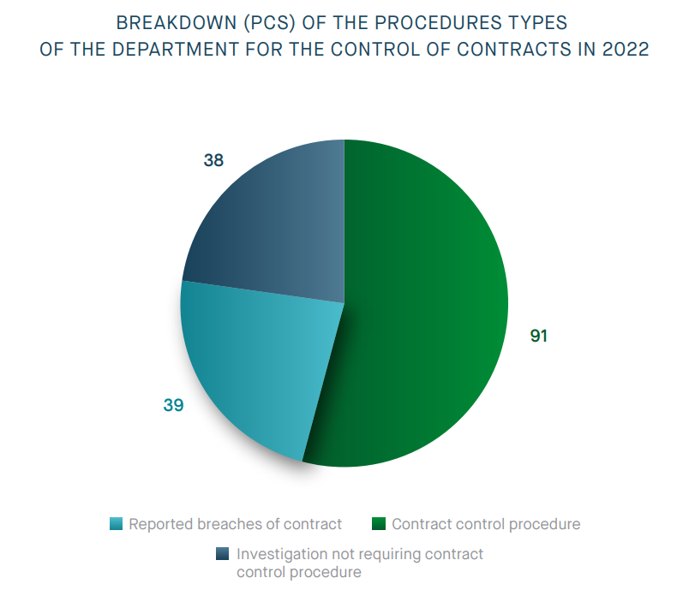
Types of control

Slide 13
The contract control procedure of the Public Procurement Authority
The control competence of the Authority (the compliance of negotiated procedures without prior publication, control of notices) :
  The control of public contracts:
  performance,
  amendment,
  detection of the related public procurement infringements
  Initiation of legal review procedures
  Initiation of a trial if the contract amendment is considered null and void
  contract violation
  absorbance of the cost of additional work
  taking of unjustified risk
Notification of other authorities

Slide 14
The contract control procedure of the Public Procurement Authority
  The main goal of the control: compliance with the conditions disclosed in the public procurement procedure, e.g.:
    Performance within deadline
    Performance at the price set in the contract
    Fulfilment of the suitability criteria
    Involvement/replacement of experts
    Performance with the products/material/services included in the offer or with their equivalents
    Compliant involvement, payment of subcontractors
    Compliance with the special (potentially restrictive) conditions set by
    the contracting authority during the performance

Slide 15
The contract control procedure of the Public Procurement Authority
  The main goal of the control: compliance with the conditions disclosed in the public procurement procedure, e.g.:
  Did the contracting authority control, document the performance of the contract
  Was the amendment of the contract compliant
  Did any contract violation occur, did the contracting authority report it to the Authority
  Did the parties comply with the other conditions laid down in the Public Procurement Act and in the applicable decrees

Slide 16
The contract control procedure of the Public Procurement Authority
  If there is any deviation from the conditions disclosed in the procedure, that is included in the contract, being subject to competition in the public procurement procedure:
  Did any modification take place in terms of the above?
  If it was necessary for the compliance, did any lawful contract amendment take place? – comparing the behaviour of the contracting parties with the legal bases of contract amendment included in the Public Procurement Act
  If not:
    Initiation of a review procedure
    Launch of a trial
Objective: supporting compliant practice, sanctioning unlawful behaviour

Slide 17
The contract control procedure of the Public Procurement Authority
Inputs of the control
Annual control plan
Modification notices
Official initiation (requests entities/persons entitled by the law)
Notification of public interest
Reporting the breach of contracts – only if public procurement infringement is suspected as well
Public Procurement Anonymous Chat (PPAC)

Slide 18
Annual control plan
Aspects of its preparation - Main aspects
Previous experience:
  Typical contracts (subject of the contract)– typical infringements (e.g.: health procurement, road construction, fulfilment of the criteria of specially applicable procedures)
  Monitoring of parties committing infringements previously, concerning another contract (repeated infringers)
  Reopening of a previous control, if it was closed prior to contract performance and an infringement occurred (repeated infringers)
If a contract was amended more times within a short period (3 times within 1 year)
Considering the objective deadline open for legal review proceedings, the selection of contracts concluded typically 1-2 years ago, concerning which a review proceeding can be initiated within deadline, by taking the time of the control also into account

Slide 19
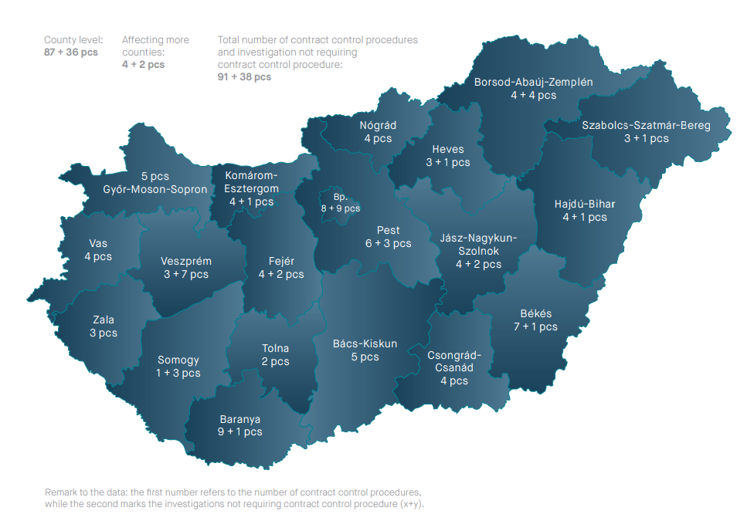
Annual control plan
Aspects of its preparation - Additional aspects
Geographic coverage (from all counties)
Wide spectrum in terms of contract value:
  Low value/national and high value /mostly above EU threshold contracts
Nearly equal amount in terms of subject-matter (public service, public supply, public works)
Annually about 80 contracts are included in the plan, the other controls are launched based on other inputs.

Slide 20
The contract control procedure of the Public Procurement Authority
Always launched ex officio – The President of the Authority is entitled to decide whether it is necessary to launch the control based on the information available
Document based control based on the data provided by the parties
  Scope: preparation of the public procurement procedure - conduct – performance of the contract concluded
On-the-spot control (Code of General Administrative Procedure – inspection)
  The PPA alone
  With partner authorities (Police, National Food Chain Safety Office)
  With experts (forensic experts)
  With expert organisation

Slide 21
The contract control procedure of the Public Procurement Authority
Deadline for the control 90+30 days
Electronic contact keeping (notification of the parties, clarification of the facts of the case)
Clarification of the facts of the case: request for access to the Electronic Public Procurement System + requesting data, documents, declarations (data provision)
Deadline for data provisions: 10 days
Excluding:
    Expert authority/expert
    Fulfilment of the request for the supply of missing data/data provision
Closing: Minutes – suggestion for the outcome of the procedure

Slide 22
The contract control procedure of the Public Procurement Authority
Outcome of the contract control:
No infringement
Public procurement infringement: legal review procedure at the Public Procurement Arbitration Board
Other infringement: competent/responsible entity
If the contract amendment is considered null and void, the President of the Authority initiates legal proceeding for the declaration of invalidity of the amendment and for the application of the legal consequence of invalidity.

Slide 23
The contract control procedure of the Public Procurement Authority
Outcome of the contract control:
Competition law infringement, suspected cartel: Hungarian Competition Authority
Criminal offence: National Tax and Customs Administration, Police
  usage of false private document
  budget fraud
  restrictive agreement in a public procurement and concession procedure
Supervisory procedure for compliance: Company court

Slide 24
The contract control procedure of the Public Procurement Authority
Other control bodies
Ministry of public administration and regional development, Managing Authorities (Government Decree No. 256/2021. (V. 18.) on the rules of using the subsidies of certain EU funds in the 2021-2027 programing period)
State Audit Office
Hungarian Competition Authority
Integrity Authority
Government Control Office
Others

Slide 25
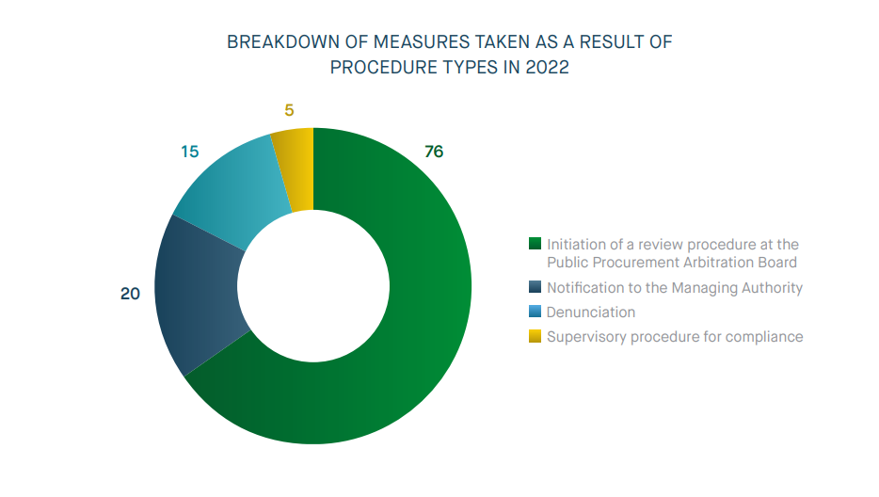
Result of the contract control in 2022

Slide 26
Typical infringements, results

Slide 27
Typical infringements found in the review procedures
More infringements can be revealed and found in one contract control procedure and in the review procedure launched based on it.
Infringement | Quantity
Violation of the control and documentation obligation | 31
Breaching the order of payment | 21
Unlawful contract amendment | 20
Incompliant involvement of the subcontractor | 17
Inappropriate preparation | 12
Failure to fulfil the request for the supply of missing information/request for data provision | 7
Incompliant provision of performance guarantee | 6

Slide 28
Failures of the preparation
Setting the performance deadline I. - successive contracts
The performance in progress in terms of contracts concluded by the contracting authority based on two public procurement procedures conducted previously prevented the handover of the working area of the contract being subject of the control and thus prevented contract compliant performance
In the case of related projects, the implementation of which affects the on schedule performance of the work contract concluded by the contracting authority as a result of a public procurement procedure, circumstances affecting contract compliant performance shall be taken into account prior to the dispatch of the call for
Upon setting the performance deadline, the contracting authority disregarded the temporal and territorial delaying effects of the already known related previous contracts, which triggered contract amended violating Article 28 (1) of the PPA – D.386/2021.

Slide 29
Failures of the preparation
Setting the performance deadline II.:
Upon setting the performance deadline, the contracting authority disregarded the construction task, the time requirement of the work types and set the performance deadline by disregarding the above.
The construction work could a priori be started (based on the building permit) after the expiration of the original performance deadline, as the builder (the applicant and the entity entitled by the building permit) was the contracting authority, thus during the preparation of the procedure it must have been well aware that it does not have a building permit necessary for starting the construction.

Slide 30
Failures of the preparation
Other
The option provisions are not set out in the public procurement documents (scope, quantity, way of usage, deadline of usage) - D.479/2022
Taking winter operation period into account upon setting the deadline (e.g. in the case of road construction)
The performance deadline was set as commencing as of the handover of the construction site, however, the date of the handover of the construction site was not determined by the contract
The prerequisite of the performance is missing: the modification of the urban planning tools is necessary for the performance of the contract; however, the related design contract was concluded only after conducting the public procurement procedure.

Slide 31
Infringements related to the involvement of subcontractors
Economic operator, who is involved by the tenderer and participates in the performance directly – exceptions: exclusive right, manufacturer, distributor, basic material, construction material dealer (Article 3. 2. of the PPA)
  Sub-sub contractor is not a subcontractor,
  Employee is not a subcontractor
Performs the public contract (in the contract, in the technical specifications, „principal service”, „ancillary service” – irrelevant, general practice)
Under any legal relationship: „agency agreement”, „always work with them”, „we had concluded a contract before being awarded the public procurement” – irrelevant as considered based on the content
Examples: Responsible technical manager, entity on the capacity of which
the economic operator relies

Slide 32
Infringements related to the involvement of subcontractors
Pursuant to Article 138(3), the contracting authority is obliged to:
Report them previously,
Make declaration about the exclusion grounds (in the draft contract),
Content of the report:
    Name
    Tax number
    Contact details
    Entitled representative
    Expected ratio in the performance
    Value of the compensation pursuant to the subcontract

Slide 33
Infringements related to the involvement of subcontractors
Report – its reason is to avoid the involved of subcontractors in the performance, who are subject to exclusion grounds
Previously: prior to the actual start of the performance
Documented in the bid, e-log, on a separate sheet etc.
The contracting authority is obliged to supervise (the technical inspector, if any):
  Not aware, because the tenderer did not report him > infringement of the tenderer
  Could have done it (it was documented), but failed to do so? >> infringement of the contracting authority
Subcontractors must be registered in the Electronic Public Procurement System (based on the report) Article 43(2) of the PPA
D.84/17/2022., D.211/13/2022.

Slide 34
Infringements concerning the order of payment
In terms of public works – prevention of debt chains
Article 32/A of Government Decree No. 322/2015
General rule: „two step” – first the payment of the subcontractor must precede the payment of the tenderer
The contracting authority was unaware of the subcontractor:
  Was it documented/appropriately reported? If yes, the contracting authority violates the law if it the favours the payment of the tenderer prior to the payment of the subcontractor
  Could not have been aware – not reported/could not notice it – only the tenderer committed an infringement
The tenderer may pay for the subcontractor earlier, but shall certify this payment to the contracting authority in order to receive its payment
If the contracting authority notices (should have noticed) unlawful payment order: holdback

Slide 35
The documentation and supervision obligation of the contracting authority
  The contracting authority did not fulfil its obligation laid down by the law, contract, call for tender etc. – violates Article 142 (1) of the PPA
  Examples:
  The performance is not documented appropriately (may prevent the pursue of claims)
  Liability insurance was unavailable at the conclusion of the contract, still, the contract was concluded
  Performance, warranty guarantees were not fully available during the period set forth
  The tenderer did not involve the experts in the performance
  The presence of unknown subcontractors on the construction site, no declaration on the exclusion grounds
  Did not supervise the payment order of the tenderer
  Accepts the reasons of the contract amendment of the tenderer without justification

Slide 36
Pursue of claims by the contracting authority
Observation of basic principles: in the public procurement procedure + also during contract performance!
Basic principles under Article 2(1)-(4) of the PPA is violated by the contracting authority
  Fair competition
  Principle of equal opportunities and equal treatment
  Principle of good faith and fair dealing
  Principle of responsible management of public funds
If claims arising from the breach of contract are not pursued (except for termination / rescission)
In cases when the breach of contract
Occurs with failure to fulfill a contractual obligation, which was considered in the public procurement procedure by the contracting authority during the evaluation of tenders; or
The performance deviates from the content of the contract to an extent which would considered to be a substantial amendment pursuant to Article 141 (6) of the PPA, should to parties have amended the contract accordingly.
Responsibility of the contracting authority → shall be stated only in terms of the
contracting authority

Slide 37
Pursue of claims by the contracting authority
Investigating the obligation to pursue claims: Always considering then characteristics of the specific case
E.g. was any sanction, other legal consequence set out in the contract for the given breach of contract, did the successful tender breach the contract, did the contracting authority request liquidated damages in due time, did it take any steps etc.
Preliminary question may be: May the successful tenderer be held liable? Was there any delay at the side of the obligee? Did any breach of contract occur?
└ Article 6:142. of the Civil Code: e.g. Can the successful tenderer certify its delay pursuant to Article 6:142 of then Civil Code?
└ Article 6:156. of the Civil Code: The obligee’s default shall exclude the obligor's simultaneous default.
└ Article 159. of the Civil Code: if in terms of the above infringement, the substantial decision on the public procurement case depends on the previous judgement of the occurrence of the breach of contract → Arbitration Board: launch of a legal proceeding (to establish the occurrence of the breach of contract)
+ with the simultaneous suspension of the procedure

Slide 38
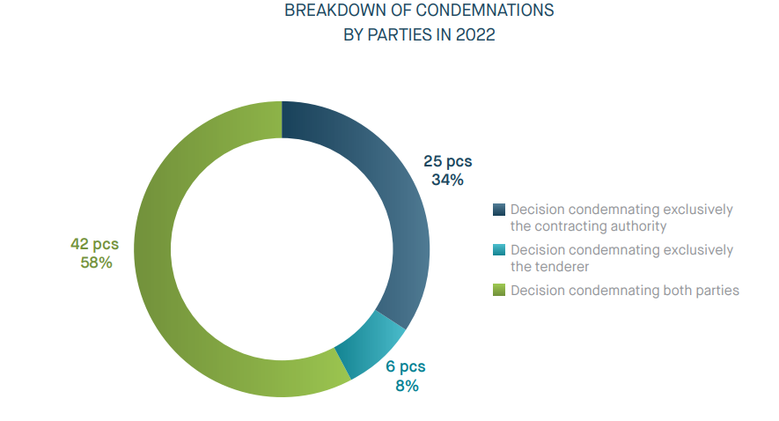
Breakdown of condemnation and fines by parties - 2022
  Fines imposed:
  On the contracting authority: HUF 278.240.000
  On the tenderer: HUF 124.100.000

Slide 39

Thank you for the attention!

